Slide 1

Database Environment
Chapter 2
Fadia Ala’eddin
Dr. Mohammed Eshtay

Slide 2
Introduction
A major aim of a database system is to provide users with an abstract view of data
Hiding certain details of how data is stored and manipulated.
The starting point for the design of a database must be an abstract and general description of the information requirements of the organization that is to be represented in the database.

Slide 3
Levels of Abstraction
Three distinct levels at which data items can be described:
External
Conceptual
Internal
The objective of the three-level architecture is to separate each user’s view of the database from the way the database is physically represented.

Slide 4
Levels of Abstraction

Slide 5
Levels
The way users perceive the data is called the external level
The way the DBMS and the operating system perceive the data is the internal level, where the data is actually stored using the data structures and file organizations.
The conceptual level provides both the mapping and the desired independence between the external and internal levels.
Notes:
The way
users perceive the data is called the external level. The way the DBMS and the
operating system perceive the data is the internal level, where the data is actually
stored using the data structures and file organizations

Slide 6
Why?
Each user should be able to access the same table, but have a different customized view of the data.
A user’s interaction with the database should be independent of storage considerations.
The internal structure of the database should be unaffected by changes to the physical aspects of storage, such as the changeover to a new storage device.

Slide 7
External Level
This level tells the application about how the data should be shown to the user.
Example: If we have login page for a university system, then as a student, we can view our attendance, courses, marks, etc. But the faculty will have a different view. They will have options like salary, edit marks of a student, enter attendance of the students, etc. So, both the student and the faculty have a different view.
Notes:
The external view includes only those entities, attributes, and relationships in the “real world” that the user is interested in. Other entities, attributes, or
relationships that are not of interest may be represented in the database, but the user will be unaware of them.
In addition, different views may have different representations of the same data. For example, one user may view dates in the form (day, month, year), while
another may view dates as (year, month, day).

Slide 8
Conceptual Level
This level describes what data is stored in the database and the relationships among the data.
This level contains the logical structure of the entire database as seen by the DBA. It is a complete view of the data requirements of the organization that is independent of any storage considerations.
However, this level must not contain any storage-dependent details.
For instance, the description of an entity should contain only data types of attributes (for example, integer, real, character) and their length (such as the maximum number of digits or characters), but not any storage considerations, such as the number of bytes occupied.

Slide 9
Conceptual Level
The conceptual level represents:
all entities, their attributes, and their relationships;
the constraints on the data (RULES);
semantic information about the data;

Slide 10
Internal Level
The physical representation of the database on the computer. This level describes how the data is stored in the database
internal level is concerned with such things as:
storage space allocation for data and indexes;
record descriptions for storage (with stored sizes for data items);
record placement;
data compression and data encryption techniques.

Slide 11
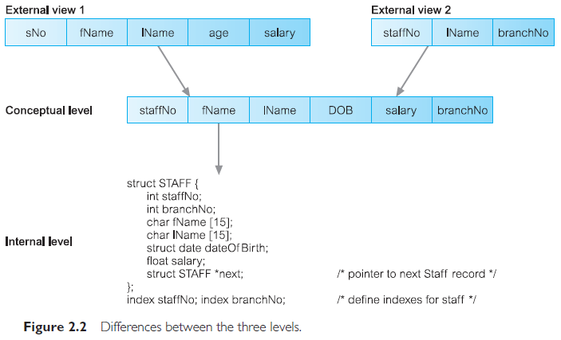
Example

Slide 12
database schema
The description of a database. (The overall description of the database is called the database schema)
Includes descriptions of the database structure, data types, and the constraints on the database.
It is important to distinguish between the description of the database and the database itself. The description of the database is the database schema.

Slide 13
Data Models
Data model: An integrated collection of concepts for describing and manipulating data, relationships between data, and constraints on the data in an organization.
A model is a representation of real-world objects and events, and their associations.
A data model represents the organization itself.
The purpose of a data model is to represent data and to make the data understandable.
Notes:
We mentioned earlier that a schema is written using a DDL. In fact, it is written
in the DDL of a particular DBMS. Unfortunately, this type of language is too low
level to describe the data requirements of an organization in a way that is readily
understandable by a variety of users. What we require is a higher-level description
of the schema: that is, a data model.

Slide 14
Data Models
There have been many data models proposed in the literature. They fall into three broad categories: object-based, record-based, and physical data models.
The first two are used to describe data at the conceptual and external levels, the third is used to describe data at the internal level.

Slide 15
Object-Based Data Models
Object-based data models use concepts such as entities, attributes, and relationships.
An entity is a distinct object (a person, place, thing, concept, event) in the organization that is to be represented in the database. An attribute is a property that describes some aspect of the object that we wish to record, and a relationship is an association between entities.
Some of the more common types of object-based data model are:
• Entity-Relationship (ER)
• Semantic
• Functional
• Object-oriented

Slide 16
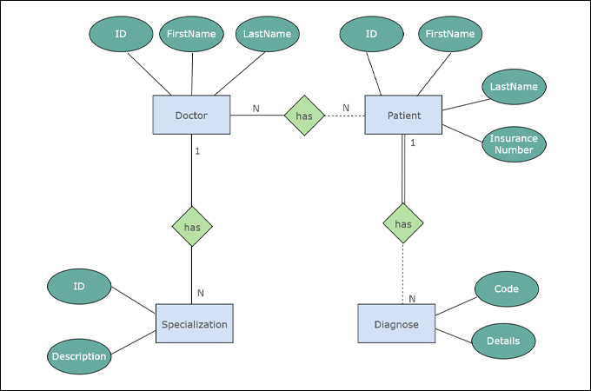
ERD Example

Slide 17
Record-Based Data Models
In a record-based model, the database consists of a number of fixed-format records, possibly of differing types. Each record type defines a fixed number of fields, typically of a fixed length.
There are three principal types of record-based logical data model: the relational data model, the network data model, and the hierarchical data model.

Slide 18
Relational data model
The relational data model is based on the concept of mathematical relations. In the relational model, data and relationships are represented as tables, each of which has a number of columns with a unique name.

Slide 19
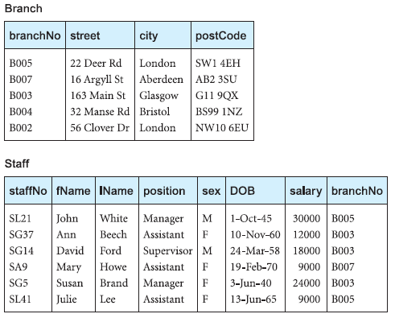
Notes:
Note that the relational data model requires only that the database be perceived by the user as tables. However, this perception applies only to the logical structure
of the database, that is, the external and conceptual levels of the ANSI-SPARC architecture. It does not apply to the physical structure of the database, which can
be implemented using a variety of storage structures.

